Slide 1
Mike Shipp
Regional Sales Manager

Slide 3
Our Brands

Slide 4
24 GLOBAL LOCATIONS
DISTRIBUTION CENTERS NORTH AMERICA
60,000 Sq Ft – Rancho Cucamonga, CA
50,0000 Sq Ft – La Miranda, CA
816,000 Sq Ft – Olive Branch, MS
150,000 Sq Ft – Guilderland, NY
250,000 Sq Ft – Cincinnati, OH
35,000 Sq Ft – Canada
SALES, ADMINISTRATION & DISTRIBUTION CENTER
PIP France - L’Hermenault, France
GLOBAL HEADQUARTERS
PIP GLOBAL - Latham, NY
SALES & EXPORT DIVISION FOR GLOBAL CUSTOMERS OR PIP ENTITIES
PIP AMEA - Shanghai, China
PIP – GLOBAL SUPPLY CHAIN
PIP Hong Kong - Hong Kong, China
West Chester Retail - Global Supply Chain - Shenzhen, China
MANUFACTURING FACILITIES
McHenry Manufacturing - Bluffton, IN
PR Industries - Chaska, MN
Black Pearl Productions - Guilderland, NY
US Mesh - North Attleboro, MA
PIP Canada - Laval (Montreal), Canada
Hearos de Mexico - Tijuana, Mexico
Uniform Technology- Longmont CO
MANUFACTURING FACILITY
Disposable Glove – Thailand
MANUFACTURING FACILITY
Pioneer - Tay Ninh, Vietnam
SALES, ADMINISTRATION & DISTRIBUTION FOR RETAIL DIVISION
West Chester - Sharonville, OH
SALES OF PROTECTIVE EAR PLUGS TO RETAIL
HEAROS LLC – Latham, NY
SALES OF UNIFORM & INSPECTION GLOVES
Century Gloves – Latham, NY
SALES OF REUSABLE APPAREL FOR CE
Uniform Technology – Longmont, CO
SALES, ADMINISTRATION & MANUFACTURING FOR SPECIALTY HAND & ARM PROTECTION PRODUCTS
Worldwide - Wilkesboro, NC and Hamburg, NY
SALES AGENCY, FOOD PROCESSING MARKET
Processing Solution - Wilkesboro, NC
SALES, ADMINISTRATION FOR GLOVES & FINGERCOTS
QRP - Tucson, AZ
PIP SALES, ADMINISTRATION & DISTRIBUTION CENTERS O-U.S.
PIP Canada - Bolton (Toronto), Canada
PIP Canada - Laval (Montreal), Canada
PIP Canada - Mississauga Canada
PIP Mexico - Monterrey, Mexico
SALES, ADMINISTRATION & DISTRIBUTION CENTERS
PIP Australia – Eagle Farm, Australia
PIP Paramount Safety – Brisbane, Australia
PIP Bisley Workwear – Sydney, Australia

Slide 6
Custom Services

Slide 7
PIP Value
Head to Toe PPE Solutions
Additional Investments / Acquisitions to complete product line
North American Manufacturing
Hi Capacity
Reduction of Supply Chain Disruptions
Digital Solutions
Best in Class Web Site
Cross Reference Tools
Online Classroom or Virtual Training Through Teams, Zoom, Etc.
Tools and Sales Support

Slide 8
Tools & Resources

Slide 9
Digital Tools – Selector Guides
Selector Guides
Welding Safety
Cut Protection
Hand Protection
Eye Protection
Chemical Resistance

Slide 10
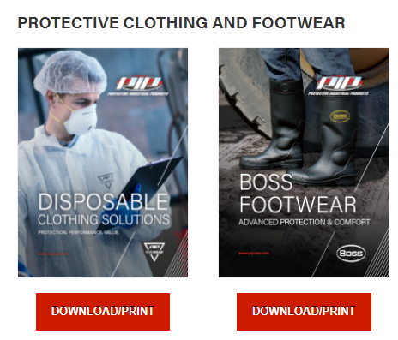
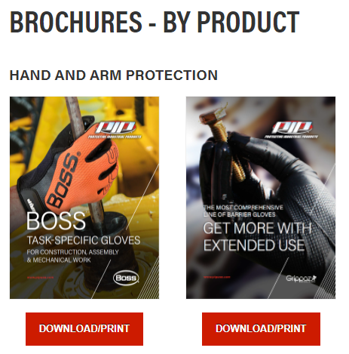
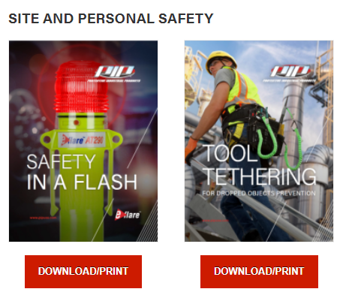
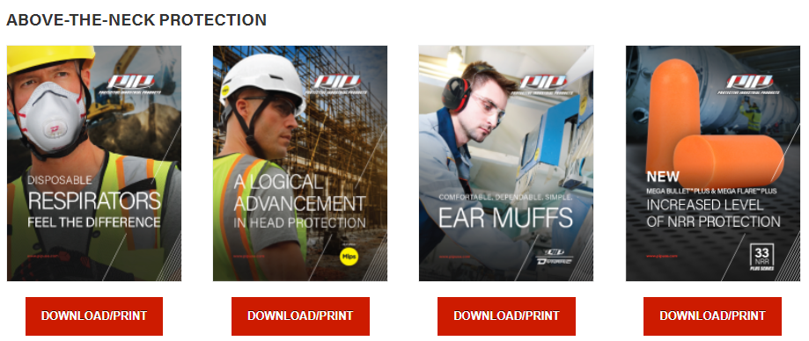
Digital Tools - Literature

